Slide 1
Linux Scavenger Hunt
Linux 3 Day 3

Slide 2

Let’s Get Ready for a
Linux Scavenger Hunt
echo "alias reload='source ~/.bashrc && echo Bash config reloaded'" >> /home/sysadmin/.bashrc
echo "alias lsa='ls -a'" >> /home /sysadmin/ .bashrc echo "alias docs='cd
Notes:
Image source: AdobeStock_302093206

Slide 3

Today, we will be you will be using a pre-configured headless Linux server and applying the skills we’ve learned over the past three weeks to complete a fun activity known as Capture the Flag (CTF).
‹#›
Notes:
Image source: Greg Elzerman

Slide 4

Setting up the headless server:
While the machine is running from your desktop, you have a few option for connecting to it:
You can use the VM’s GUI and login directly.
If you would like to work from the command line, you can connect using ssh. (As demonstrated by the instructor.)
>_
Notes:
shutterstock_1202854222

Slide 5

CTF Instructions and Rules
You can work alone or in teams.
If working with a team, all members must participate equally.
To complete this CTF, you will launch a headless VM and login.
All previous material and internet resources are fair game.
While each member can work on different steps, most steps must be completed in order.
Professors and TAs will not be providing hints or assistance unless there are technical issues that prevent the VMs from running correctly.
‹#›

Slide 6
Hints
Take note of anything interesting that you find..
Each flag has the following format:: flag_1:97df27aec8c251503f5e3749eb2ddea2
There are eight flags in total. The first seven flags will be combined to create the final flag.
Write down any credentials you find. You may need to use them later.
‹#›

Slide 7


Let’s Get Started: 2 Hours
CLICK TO START TIMER
‹#›
Notes:
Timer link: https://savvytime.com/timer/2hour00minute

Slide 8
‹#›

Slide 9
Azure Lab Set Up

Slide 10

Next week, we will begin to learn system administration and security tools for one of the most popular operating systems: Windows.
For that unit, we need to use a new Azure lab environment.
Notes:
Image source: shutterstock_1149661154

Slide 11
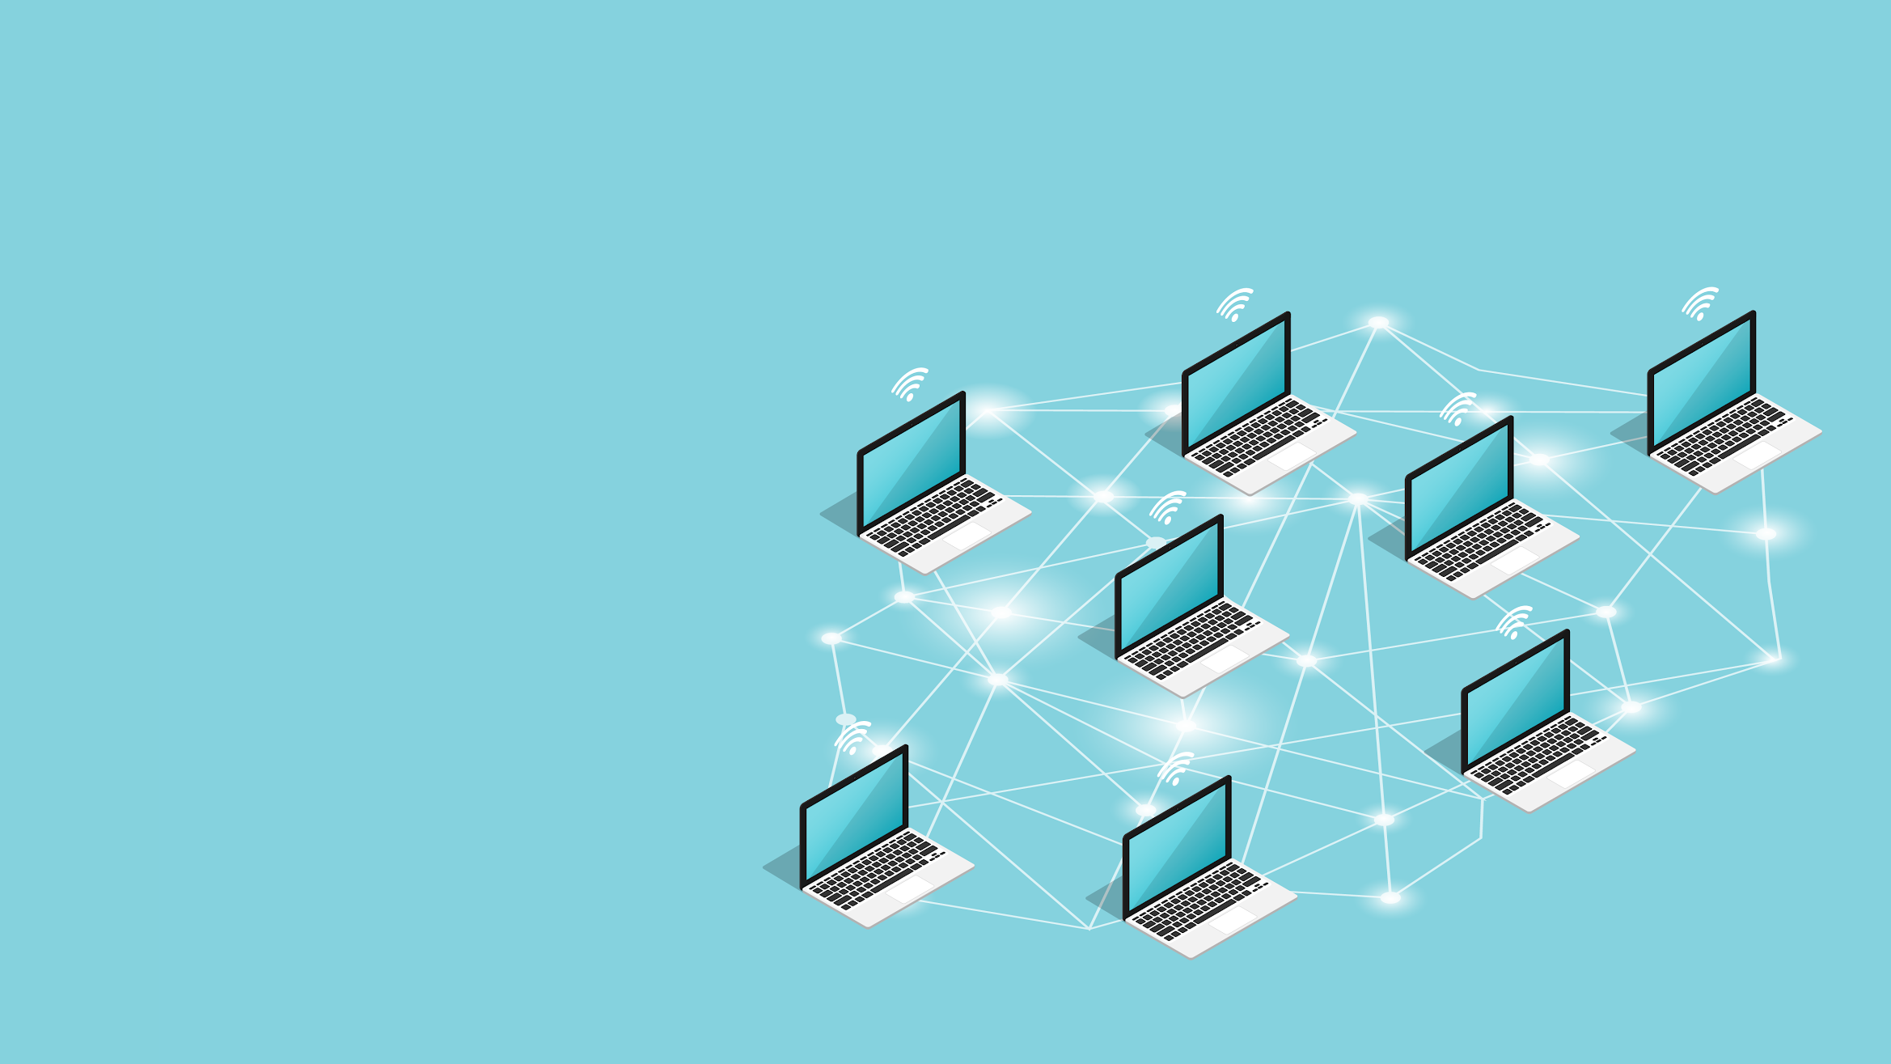
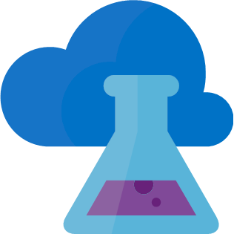
Azure Lab Services
Up until now, we’ve only needed to have access to a single virtual machine.
Starting next week and in several other units in the program, we will be accessing lab environments that are composed of multiple VMs.
‹#›
Notes:
AdobeStock_170811105

Slide 12
Azure Lab Services
Azure Lab Services will be used in the following units:
Windows Administration and Hardening
Network Security
Web Vulnerabilities
Pentesting I and II
Project 2: Red Team vs. Blue Team
Forensics
Final Project
‹#›

Slide 13
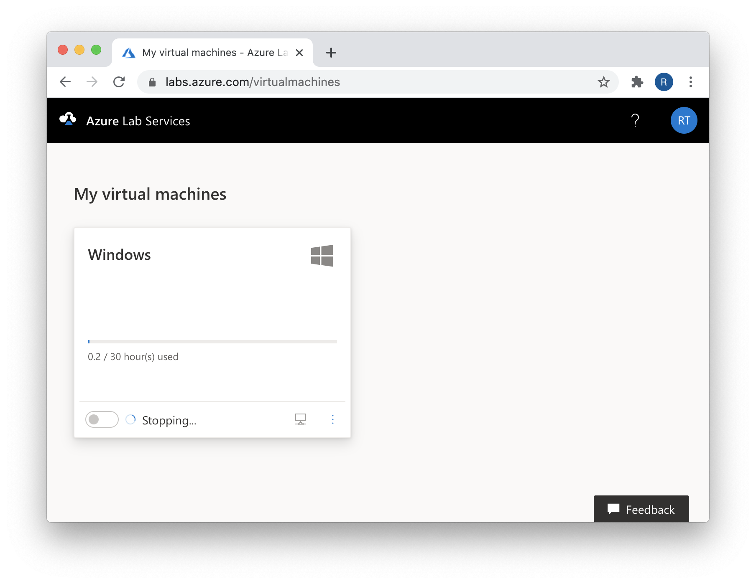
Lab Hours Quota
You will have access to labs during and after class.
Machines will start up automatically prior to class and will automatically shut down when class is over.
Outside of class hours, each student will be provided 30 hours of Azure lab access.
If students exceed that quota, they will be provided an additional 10 hours.
If they exceed those additional hours, they will be provided an additional 5 hours. Once students exceed that final quota, they will not be provided any additional hours.

Slide 14
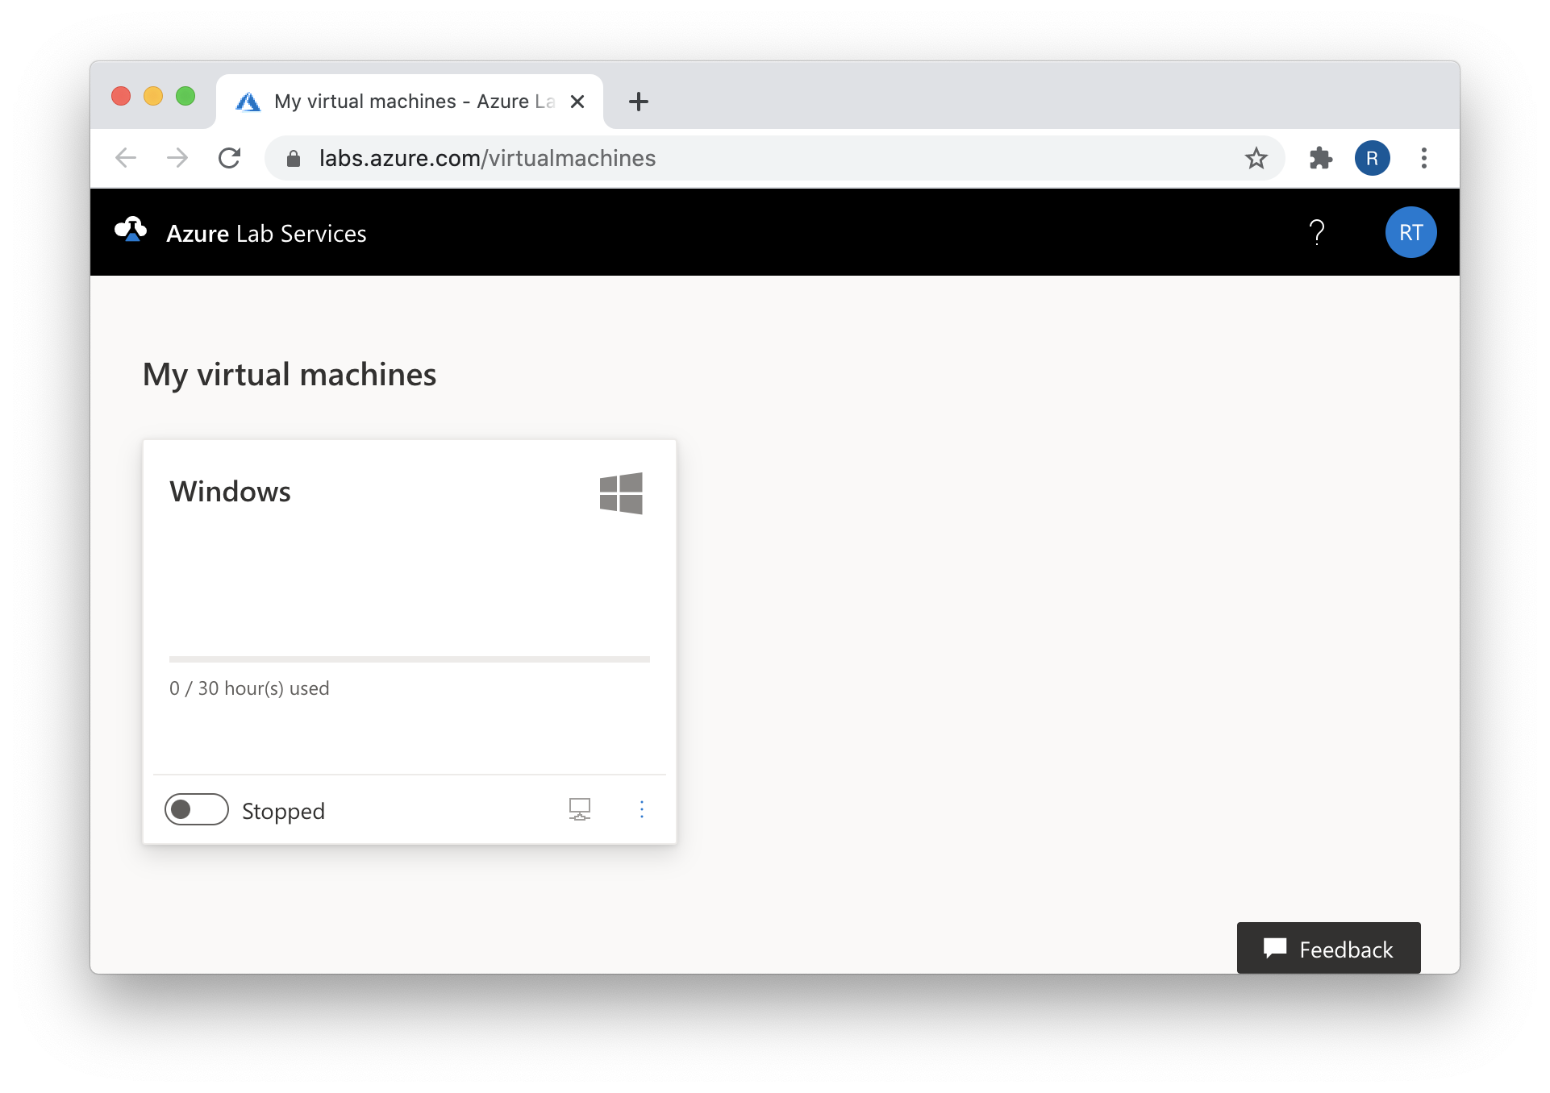
Lab Hours Quota
You must properly shut off their machines or they will lose their quota hours.
It is important to properly shut off these lab environments.
If students do not, they will accidentally use up their quota hours.
Students can see how many quota hours they have remaining on the lab environment card in the Azure dashboard.

Slide 15


Retaining Lab Work
Your work will not be deleted between classes.
The machines’ hard drives don’t delete anything unless you choose to.
However your lab environment needs to be reset, all work will be deleted.
For example, VMs can be reset if you accidentally misconfigure your environment or have issues with any of the individual machines in an environment.

Slide 16
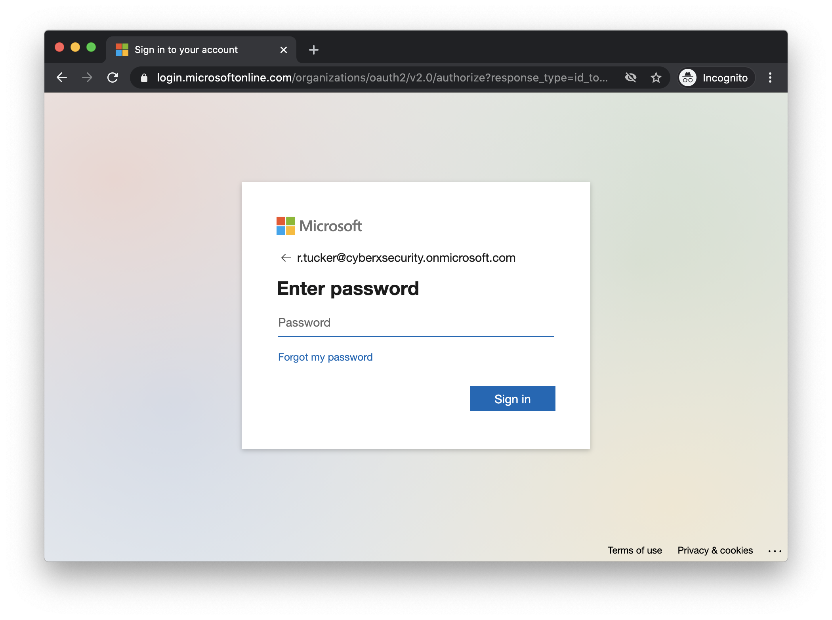
Remember Your Passwords!
You must remember your passwords.
When you access Azure for the first time, you will be prompted to create new passwords. It is recommended that you store these passwords using a password manager.
It will take up to 36 hours to reset a password.

Slide 17
You will now receive your registration link and unique Azure login credentials.

Slide 18


Logging In via RDP
We will connect to our VMs using Remote Desktop Protocol (RDP), a proprietary protocol that allows us to log into and interact with a remote machine.
In order to use RDP, you must install an RDP Client.
macOS RDP Client
Windows RDP Client

Slide 19
Azure RDP Demonstration

Slide 20


Hyper-V
All of the lab environments consist of one or more VMs running inside of a Windows host, using a technology called Hyper-V.
In other words, you will connect to a Windows computer which contains several VMs inside of it.
Windows RDP Host VM
Access VMs via Hyper-V
Therefore, even when class will use Linux operating systems or other VMs, we will still connect to a Windows machine first.
Windows 10 VM
Windows Server VM

Slide 21
Hyper-V Manager

Slide 22

Hyper-V Saved State
Hyper-V VMs should be shut down after every session in order to avoid the Hyper-V Machine going into a hibernation known as a Saved State
If a machine goes into a saved state, you may see the error The application encountered an error while attempting to change the state of the 'VM-Name'.
Hyper-V Manager
The application encountered an error while attempting to change the state of the 'VM-Name'
We can pre-empt this by deleting the saved state on the Hyper-V machine.
See details
Close
Notes:
shutterstock_309813590

Slide 23
Clearing Saved State

Slide 24
VM Credentials
Below are the credentials for the Windows RDP Host machine.
Below are the credentials for the two nested Hyper-V virtual machines. You will use these VMs on 7.3.
This is the only machine you'll need for 7.1 and 7.2
Credentials for the Windows 10 virtual machine
Credentials for the Windows Server virtual machine
Username: azadmin
Password: p4ssw0rd*
Username: sysadmin
Password: cybersecurity
Username: sysadmin
Password: p4ssw0rd*

Slide 25
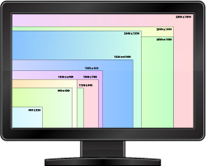
Adjusting Screen Resolution
Because we are using a virtualized environment for the Windows 10 machine, the screen resolution may not fill the entire screen during demos.
To adjust screen resolution:
01
Log into the Windows 10 VM and right-click anywhere on the screen.
02
In the new tab that opened scroll down to Display Settings.
03
A new Display window will pop up. Navigate to Display resolution and adjust the resolution to match your screen from here.
Notes:
shutterstock_137359763

Slide 26
⚠️ Important ⚠️
You will be provided 30 hours of Azure lab access. If you exceed that quota, you will be provided an additional 10 hours. If they exceed those additional hours, you will be provided an additional 5 hours.
Once you exceed that final quota, you will not be provided any additional hours. It is extremely important that you preserve your allotted hours by shutting off your machines at the end of each class.

Slide 27

Shutting Down Your Machine
When you’re done with your lab, you will need to:
01
Turn off the nested VMs inside of Hyper-V.
02
Close the RDP connection to turn off the host VM.
Open the Hyper-V Manager
Click on the Windows 10 machine in the center panel and then click Turn Off in the bottom-right pane.
Do the same for the Windows Server VM.
Simply click the red in the top-left corner of the RDP window.
This will cause the host VM to automatically turn off after 10 minutes.
However, in order to always ensure that the environment is turned off, click the Stop button in the bottom-left of the lab card in the Dashboard.

